Slide 1
Introduction to Node.js
Lesson 9.1

Slide 2
What Is Full-Stack Web Development?

Slide 3
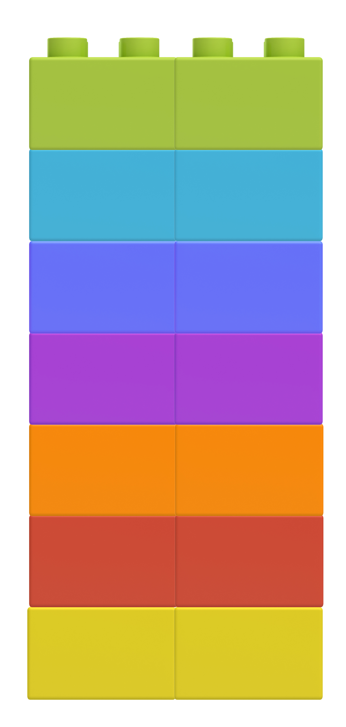
Full-Stack Web Development
HTML
Full-stack web development encompasses the suite of tools required to build both the front and back ends of a web application.
CSS
JavaScript
API
Node.JS
Express.JS
MySQL

Slide 4
How Much of the Stack Do We Know?

Slide 5
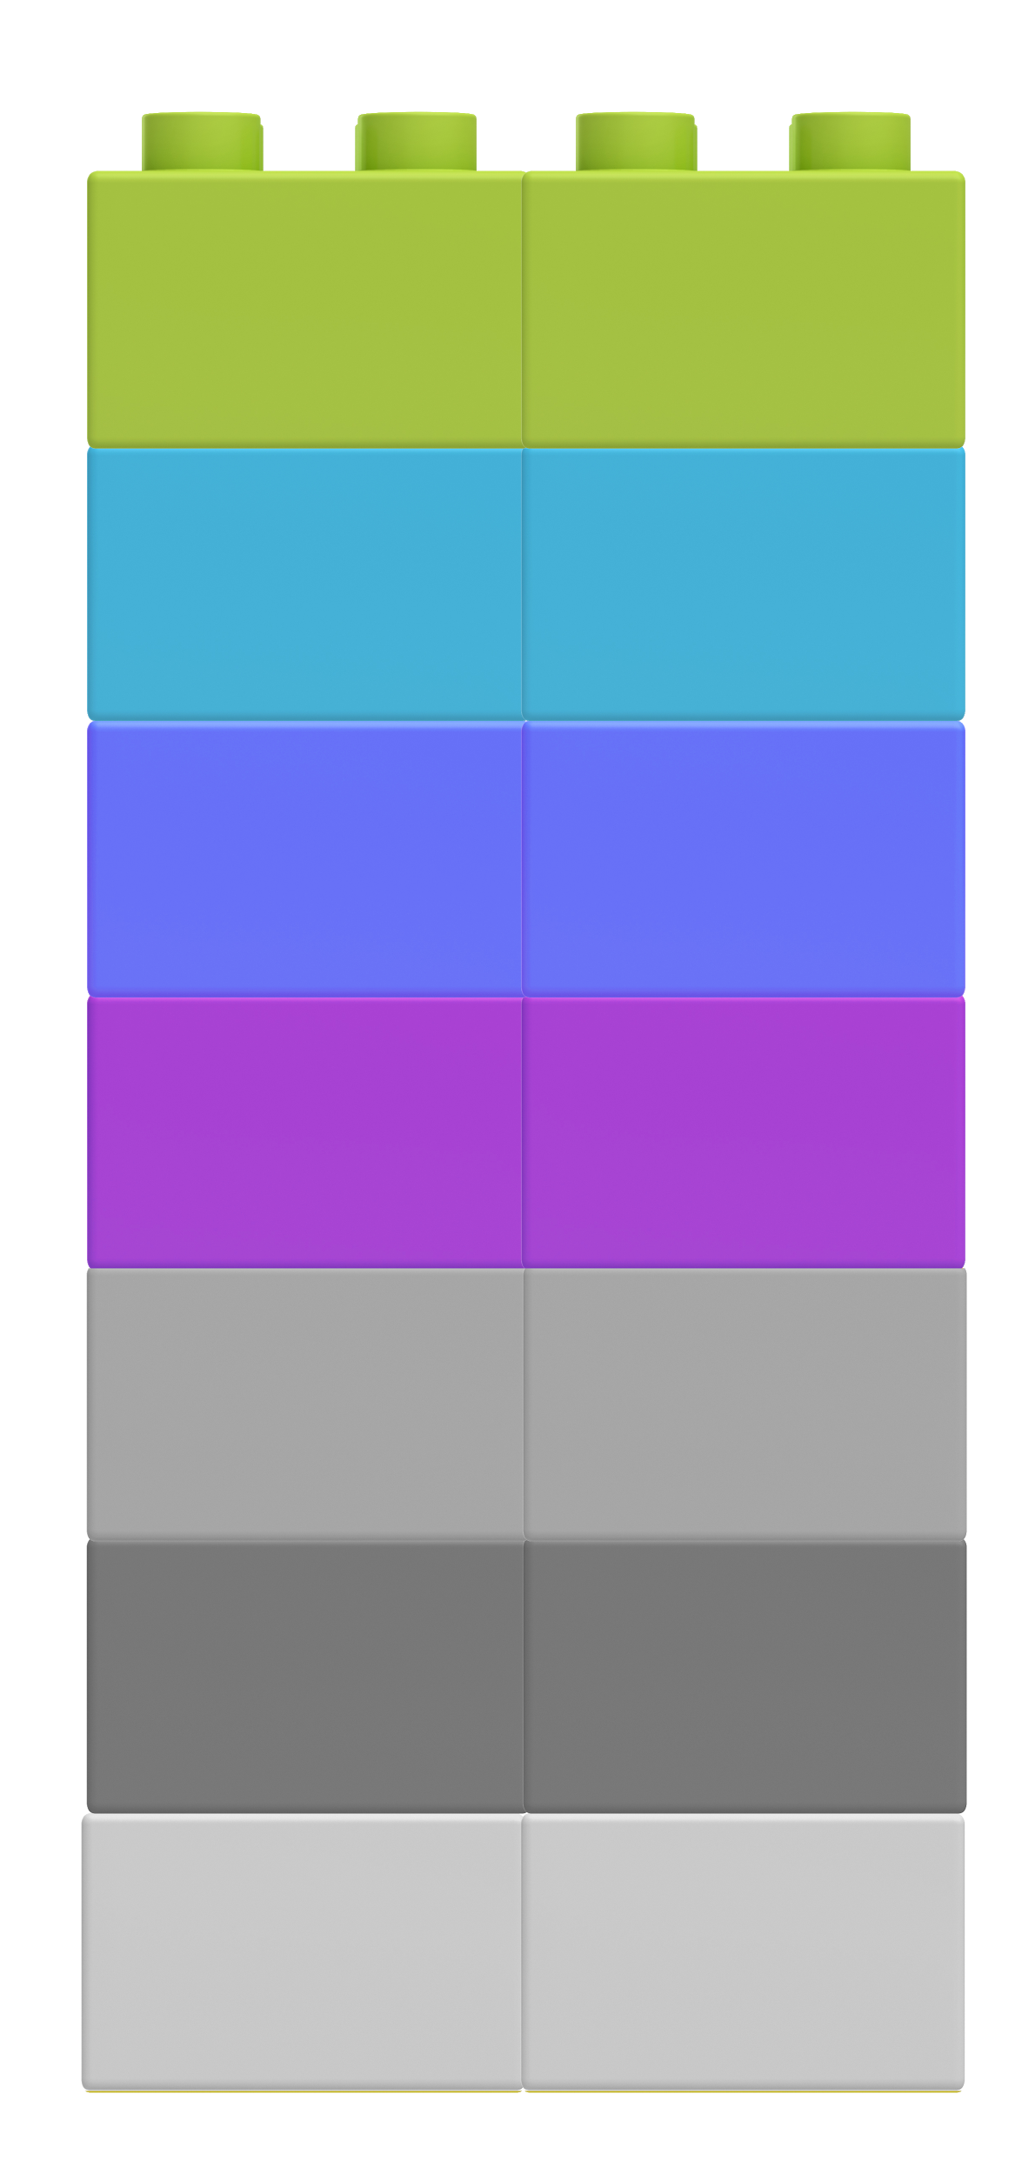
Client-Side
HTML
HTML
CSS
JavaScript
APIs
Further reading: wikipedia.org/wiki/Client-side
CSS
JavaScript
API
Node.JS
Express.JS
MySQL

Slide 6
What Is a Client?

Slide 7

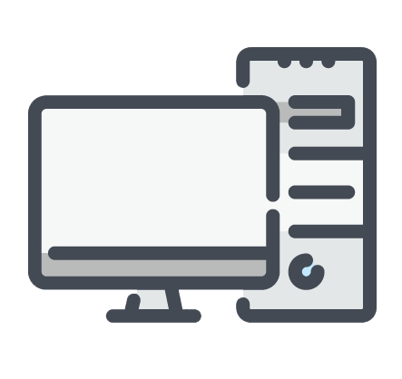
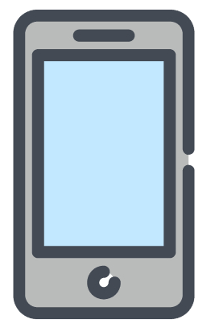
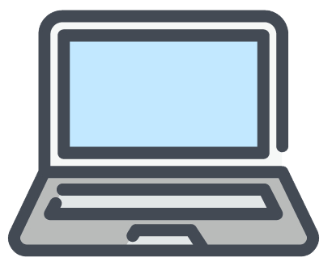
A client is a piece of computer hardware or software that accesses a service made available by a server. It can be a desktop computer, laptop, mobile device, and beyond! Further reading.
Notes:
Trilogy made diagram, does not violate copyright laws.

Slide 8
What Is GitHub Pages Doing?

Slide 9

Awesome Project Deployed to GitHub Pages
GitHub Pages is serving content to clients.

Slide 10
What Is a Server?

Slide 11
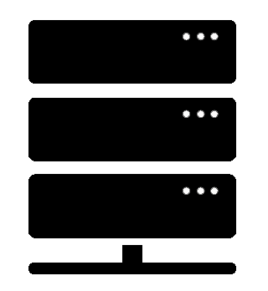
Server Definition
Depending on the context, a server is both the physical hardware and software that hears requests from users and returns something, such as an HTML or image file, or completes a process.
var http = require("http");
var PORT = 8080;
​
function handleRequest(request, response) {
response.end("It Works!! Path Hit: " + request.url);
}
​
var server = http.createServer(handleRequest);
server.listen(PORT, function() {
console.log("Server listening on: http://localhost:" + PORT);
});
Server

Slide 12
What Is the Client-Server Model?

Slide 13
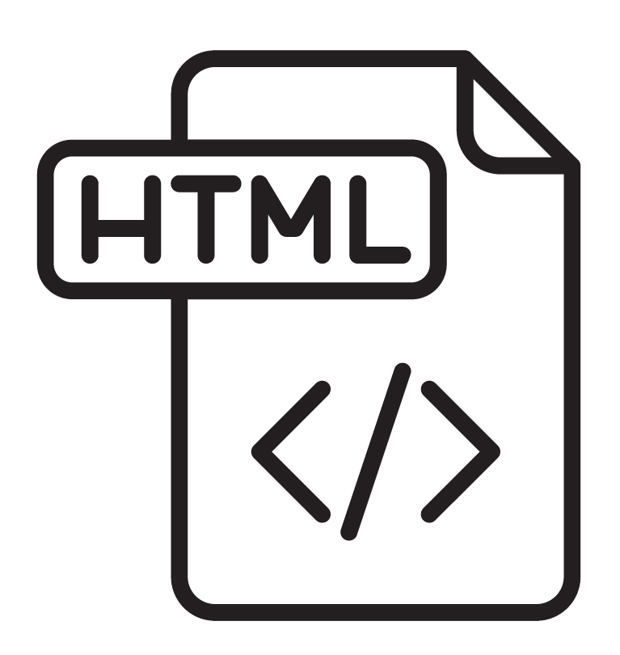
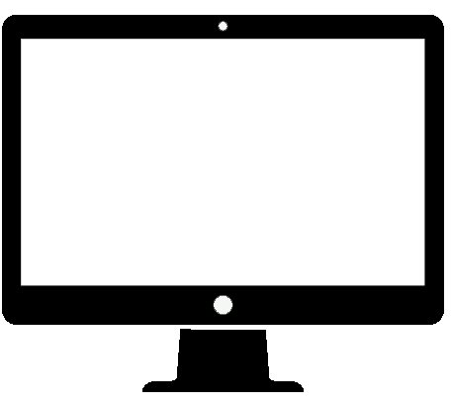
The Client-Server Model
In modern web applications, there is constant back-and-forth communication between the visuals displayed on the user’s browser (the front end) and the data and logic stored on the server (the back end).
The client's request contains the name and address
(the URL) of what the client is looking for.
The server typically has lots of content that it can return to clients. That content can be web pages, JPEGs, and other resources.
Client Request
Server
Web Browser (Client)
Response
The server's response contains the actual
document that the client requested (or an
error code if the request could not be processed).
Notes:
Trilogy made diagram, does not violate copyright laws.

Slide 14
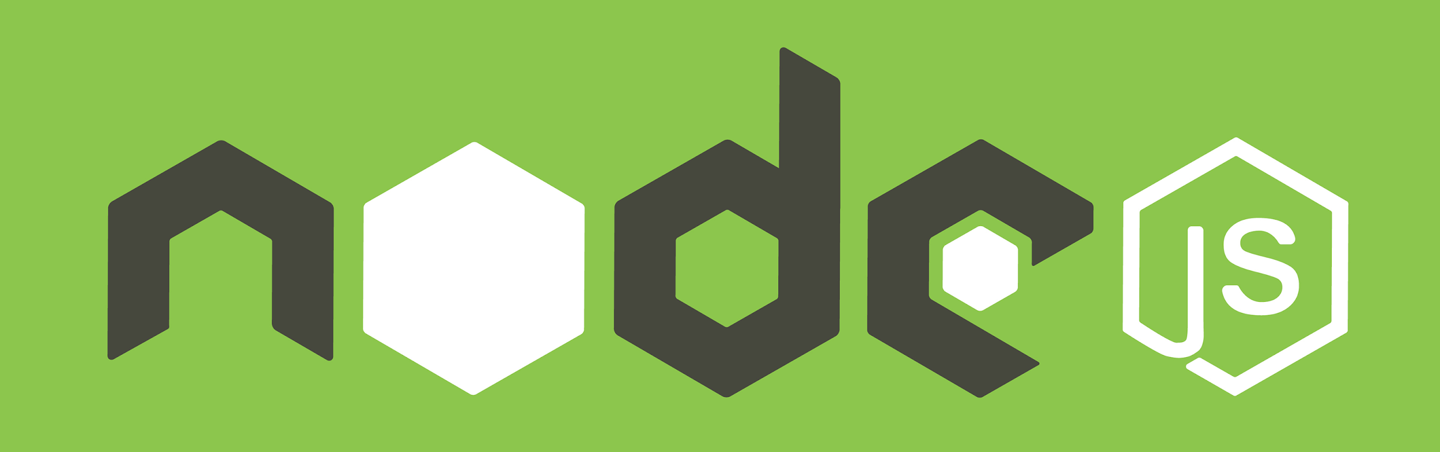
Key Question:
So What Is NodeJS?
Notes:
Image source: shutterstock_538363666

Slide 15
Definition of NodeJS
Node.js is an open source, cross-platform JavaScript runtime environment designed to be run outside of the browser.
It is a general utility that can be used for a variety of purposes including asset compilation, scripting, monitoring, and most notably as the basis for web servers.

